Slide 1
Prediction of winner in NBA basketball games
Zejian Zhan

Slide 2
Outline
Motivation
Data extraction
Model and Data analysis
Feature analysis
Algorithms and results
Conclusion

Slide 3
Motivation
Predicting the winner in a game based on the previous performance is very valuable to business managers, coaches, players, fans, gamblers, and statisticians alike.
Try to find the better algorithm for this prediction with box scores

Slide 4
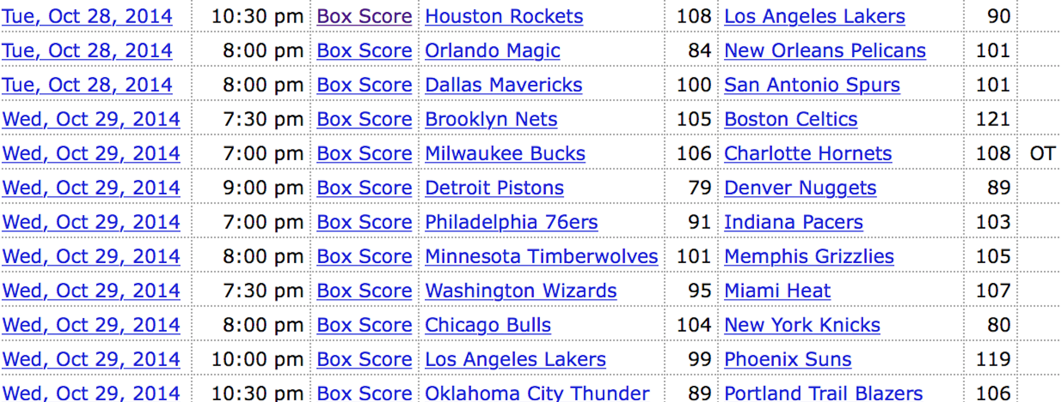
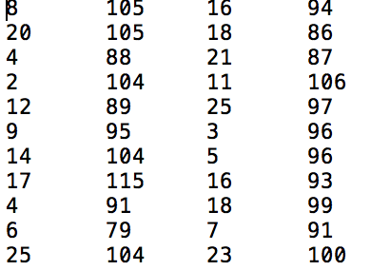
Data Extration
Copy & paste to Excel and write a macro to convert string of team names to integer value ranging from 1 to 30

Slide 5
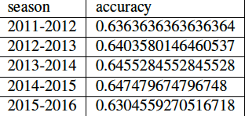
Naïve way for prediction
We can compute the win percentage of both teams, and choose the one whose percentage is higher
The result is like:
Average should be around 64%.

Slide 6
Features
Win percentage should be taken into consideration
Average point differential is a good way to show the strength of a team
We should also look at the recent performance of teams:
win percentage in recent N games
average point differential in recent N games
Win percentage as a visiting team and as a home team

Slide 7
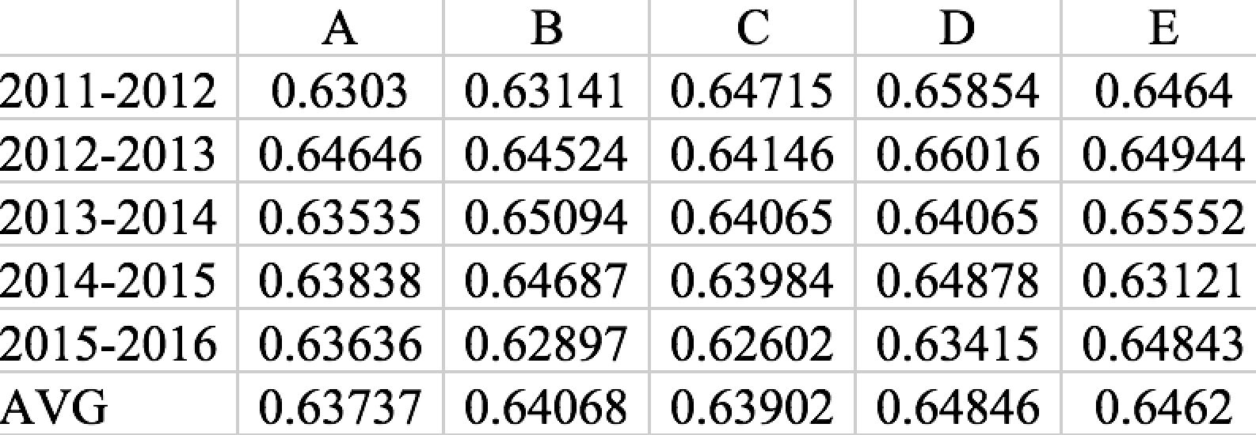
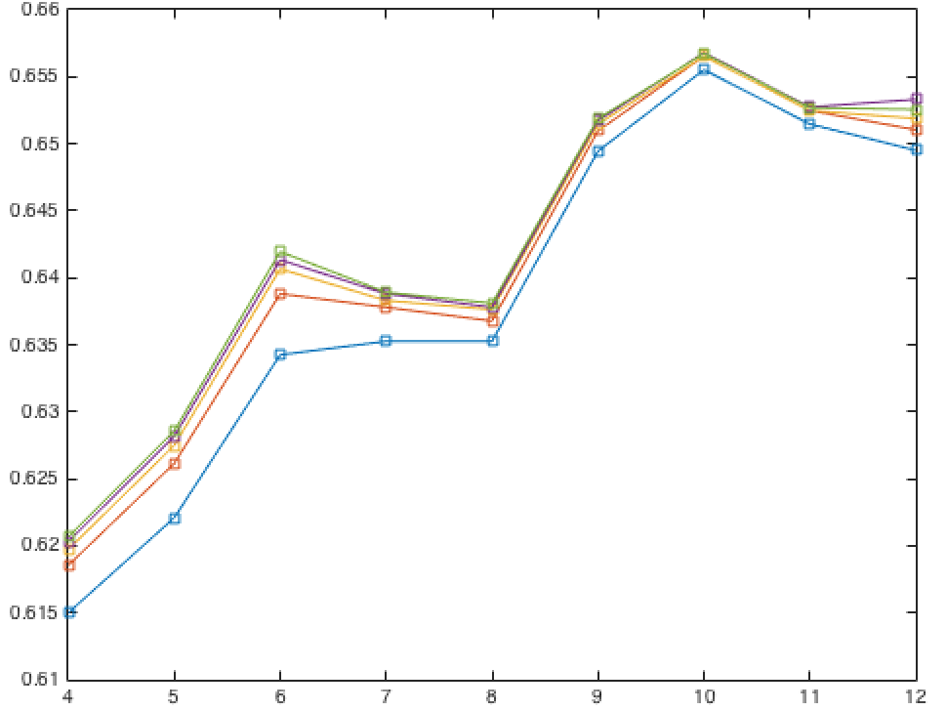
Features analysis

Slide 8
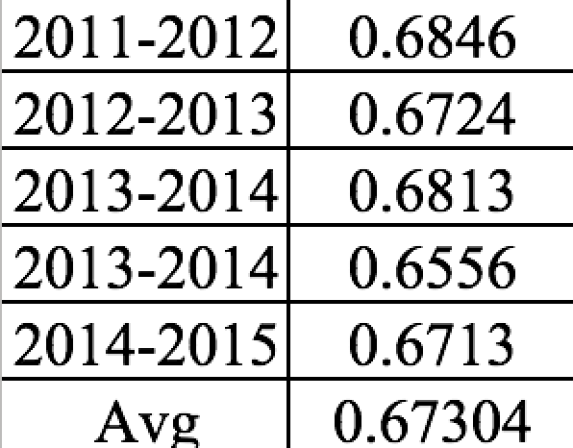
SVM
Using existing function call in matlab with linear kernel

Slide 9
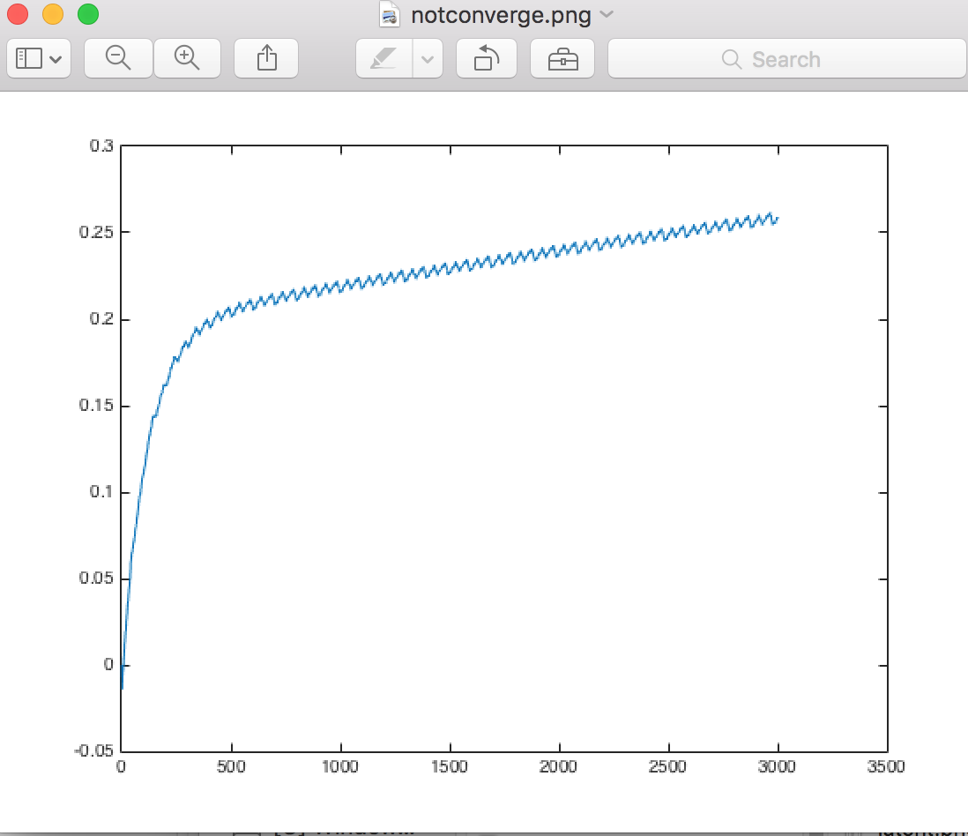
Linear regression
Not converged
after huge iteration

Slide 10
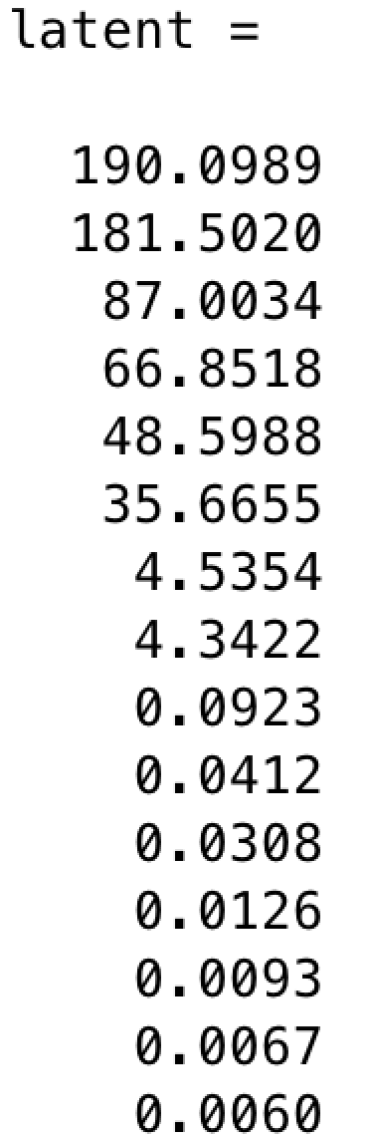
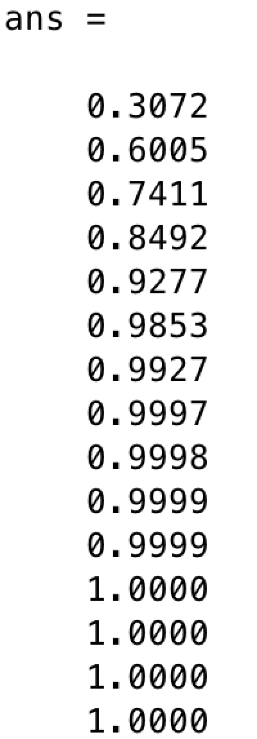
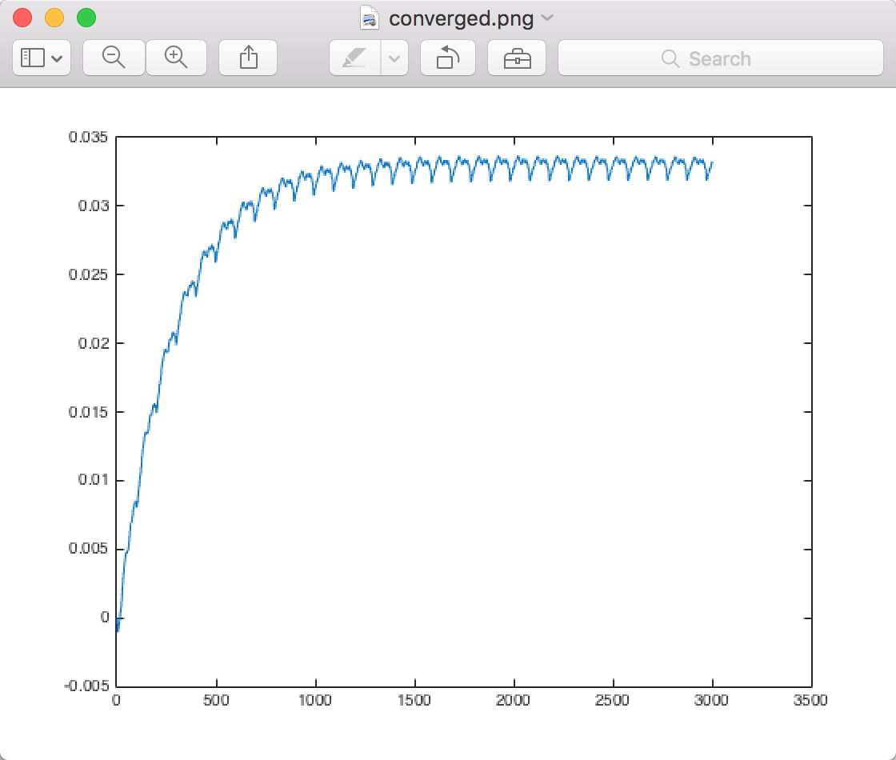
PCA
Reduce the dimension and boost the convergence

Slide 11
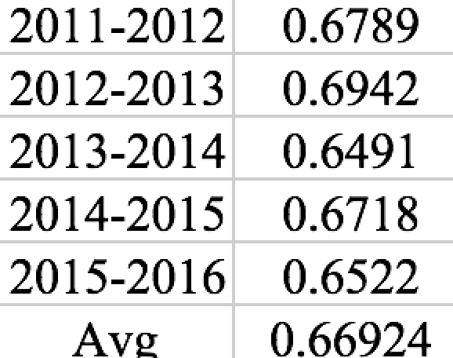
Result of linear regression

Slide 12
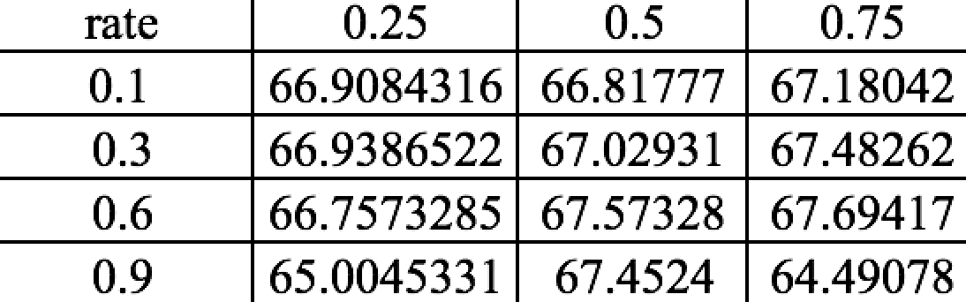
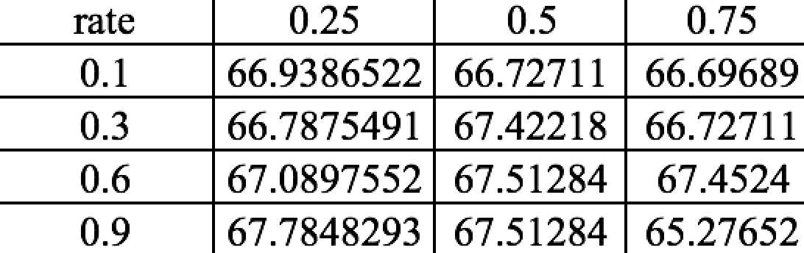
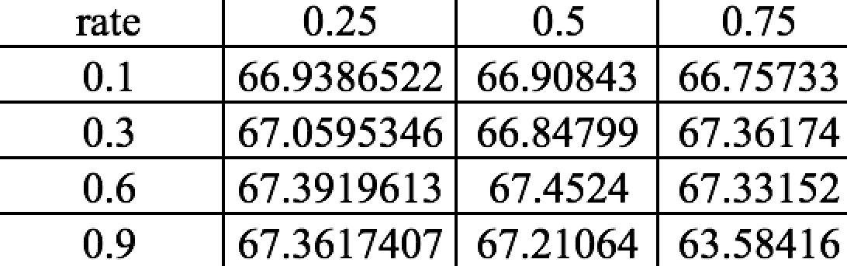
Multi-layer Perceptron
α takes 0.1 0.3 0.6 0.9 and momentum takes 0.25 0.50 0.75
One layer with four neurons
One layer with eight neurons
Too few hidden units will generally leave high training and generalization errors due to under-fitting. Too many hidden units will result in low training errors, but will make the training unnecessarily
slow, and will often result in poor generalization
One layer with twelve neurons

Slide 13
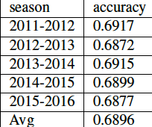
‘Optimal’ pick
Two hidden layers with eight and twelve neurons for each layer respectively

Slide 14
Conclusion and future works
All algorithms got greater than 64% accuracy
The Multilayer Perceptron with two hidden layers got the best accuracy: 69%
Need to import teams’ detailed statistics by using SQL to store all players’ statistics and executing queries for obtaining better and detailed features to measure teams’ performance

